Slide 1
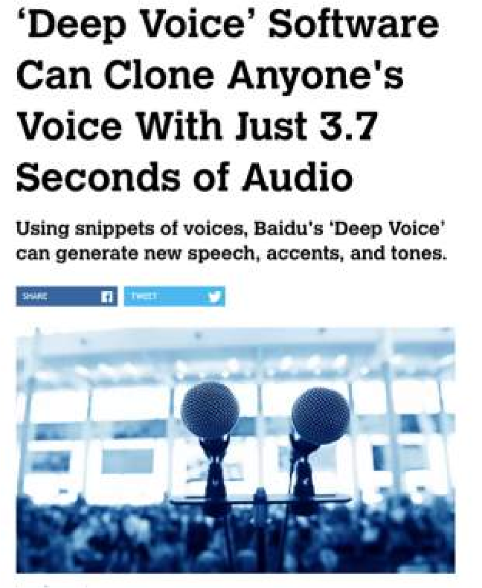






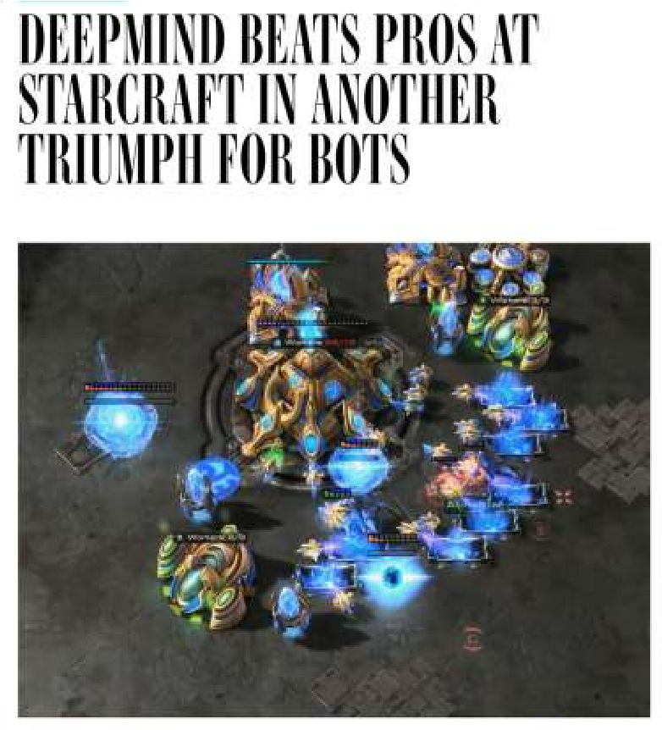

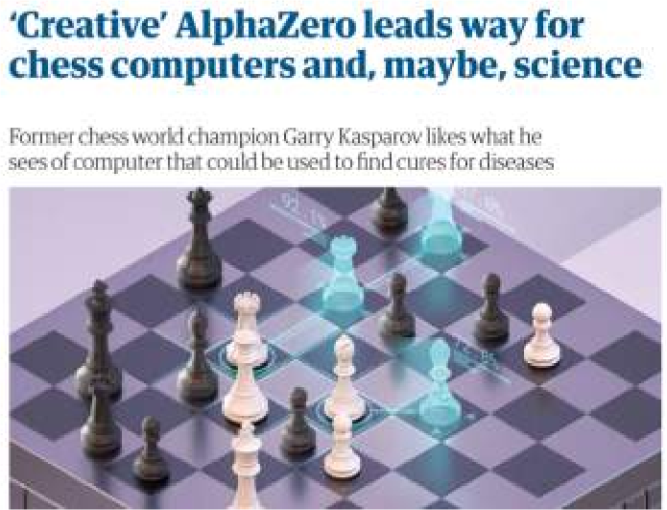


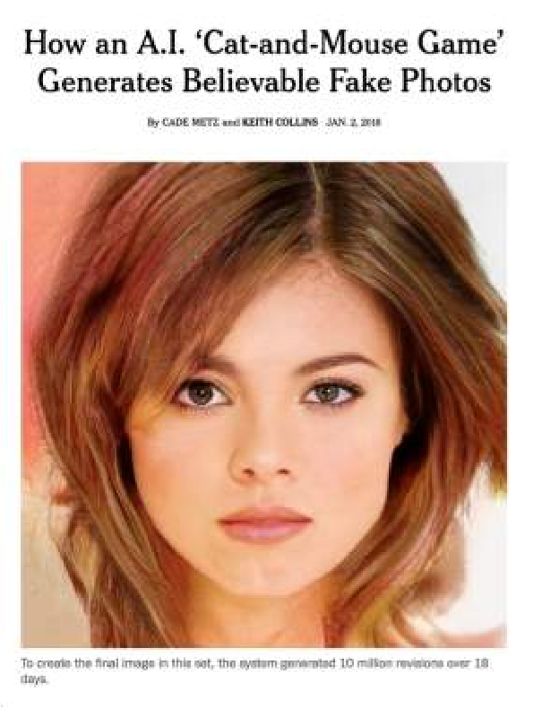
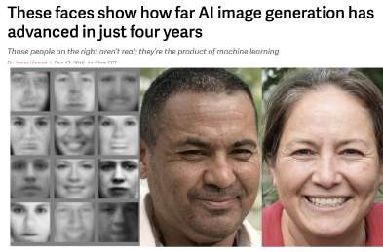



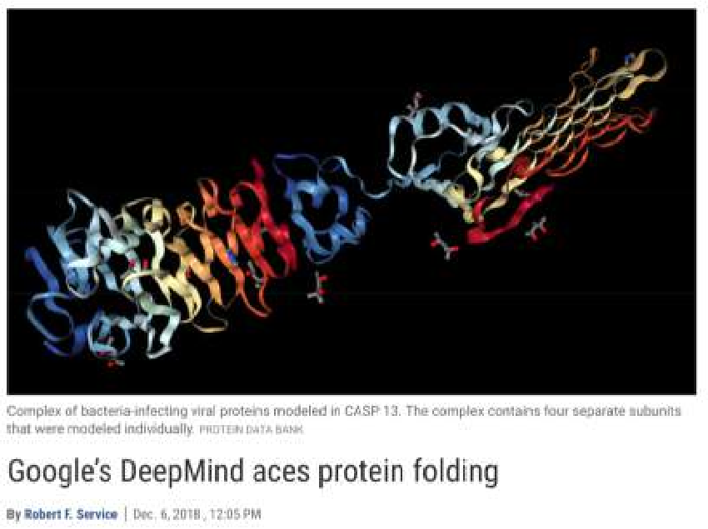
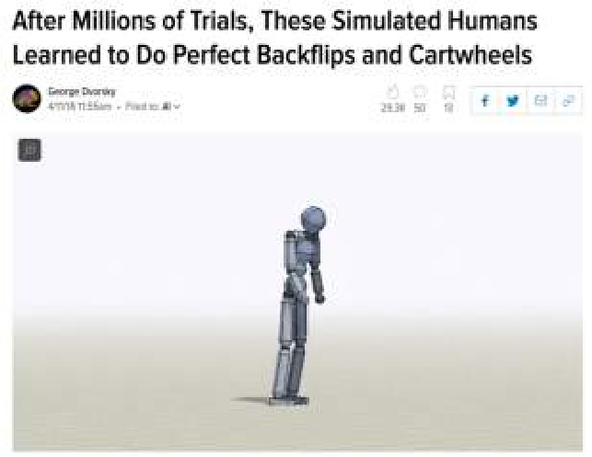


The Rise of Deep Learning

Slide 2
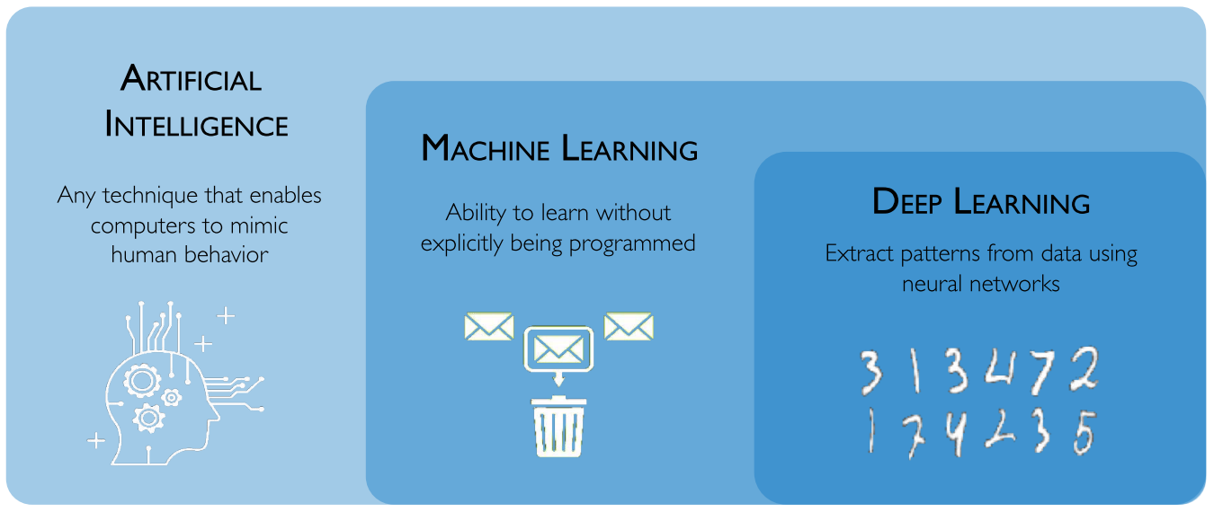
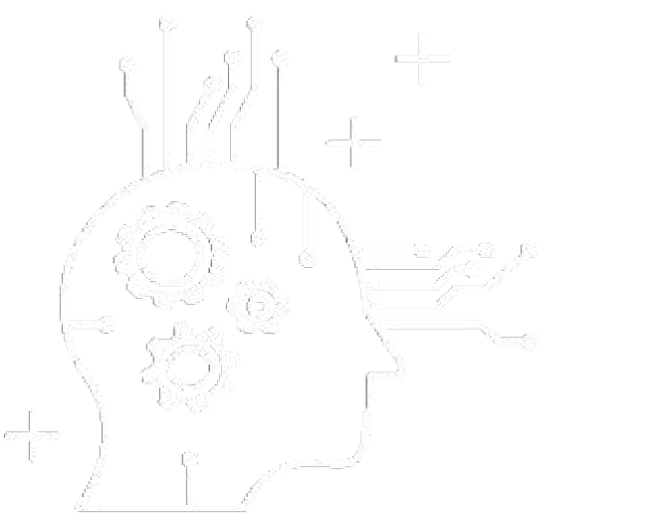
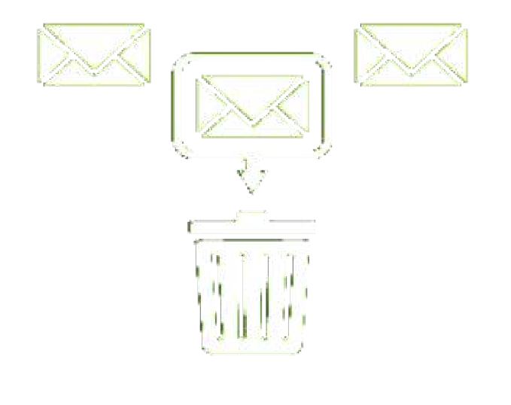
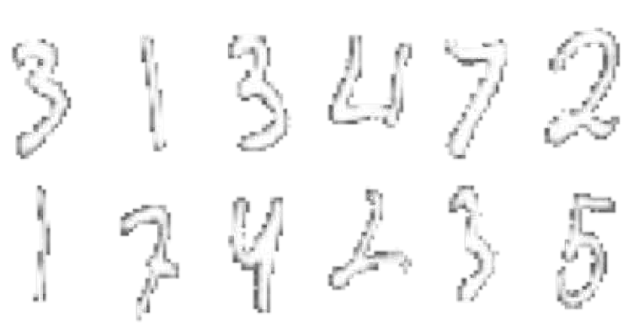
What is Deep Learning?
Artificial Intelligence
Any technique that enables computers to mimic human behavior
Machine Learning
Ability to learn without explicitly being programmed
Deep Learning
Extract patterns from data using neural networks

Slide 3
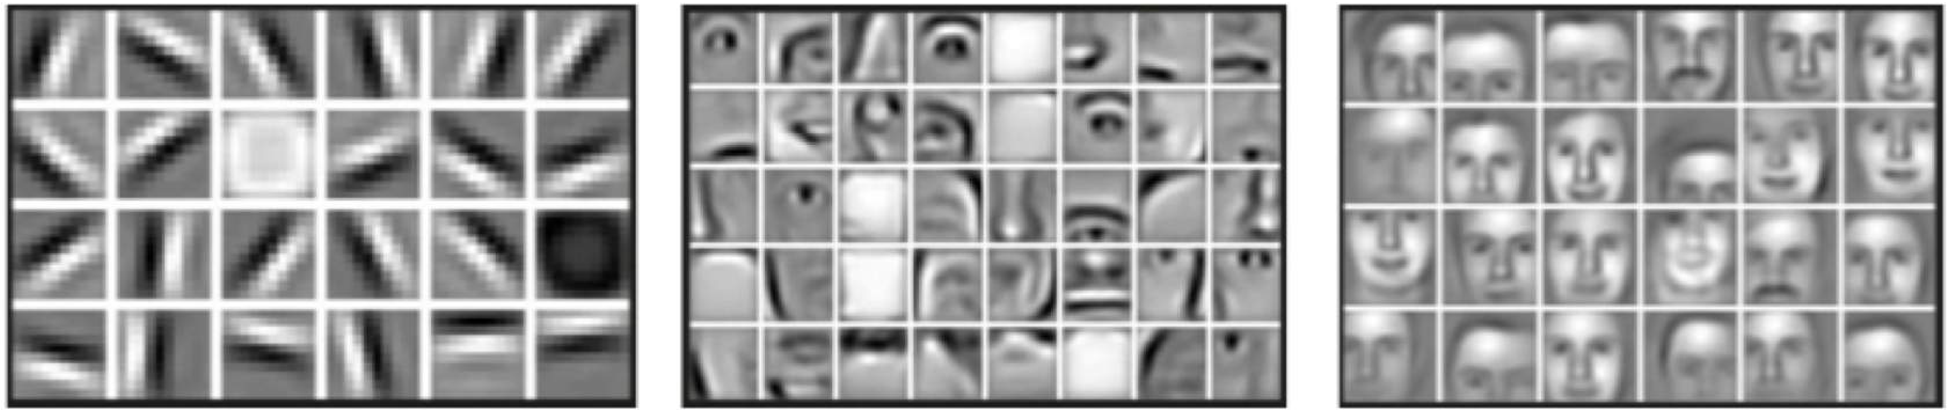
Why Deep Learning?
Hand engineered features are time consuming, brittle and not scalable in practice Can we learn the underlying features directly from data?
Low Level Features
Mid Level Features
High Level Features
Lines & Edges
Eyes & Nose & Ears
Facial Structure

Slide 4


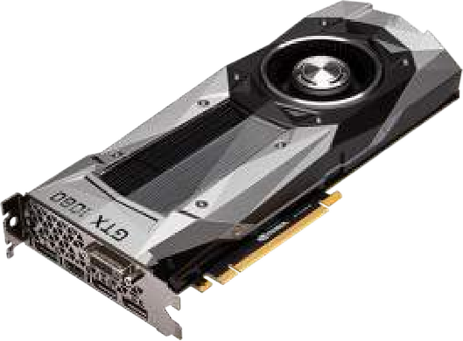


Why Now?
Neural Networks date back decades, so why the resurgence?
1952
Stochastic Gradient Descent
1. Big Data
Larger Datasets
Easier Collection & Storage
2. Hardware
3. Software
Improved Techniques
New Models
Toolboxes
1958
Perceptron
Learnable Weights
Graphics Processing Units (GPUs)
Massively Parallelizable
1986
Backpropagation
Multi-Layer Perceptron
1995
Deep Convolutional NN
Digit Recognition

Slide 5

The Perceptron: Forward Propagation
Output
Linear combination of inputs
𝑥₁
𝑤₁
𝑚
∑ 𝑥 _{𝑖} 𝑤 _{𝑖}
𝑖 = 1
𝑦^ = 𝑔
𝑤₂
Σ
𝑥
2
𝑦^
𝑤_{𝑚}
Non-linear activation function
𝑥
𝑚
Inputs
Weights
Sum
Non-Linearity
Output

Slide 6
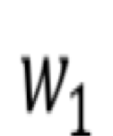
The Perceptron: Forward Propagation
Linear combination of inputs
1
Output
𝑤₀
𝑚
𝑤 ₀ + ∑ 𝑥 _{𝑖}
𝑖 = 1
𝑥₁
𝑤₁
𝑤₂
𝑦^ = 𝑔
𝑤 _{𝑖}
Σ
𝑦^
𝑥₂
Non-linear activation function
Bias
𝑤
𝑚
𝑥_{𝑚}
Inputs
Weights
Sum
Non-Linearity
Output

Slide 7
The Perceptron: Forward Propagation
1
𝑤₀
𝑚
𝑤 ₀ + ∑ 𝑥 _{𝑖} 𝑤 _{𝑖}
𝑖 = 1
𝑦^ = 𝑔
𝑥₁
𝑤₁
𝑤₂
𝑤_{𝑚}
Σ
𝑦^
𝑦^ = 𝑔
𝑤 ₀ + 𝑋 ^{𝑇} 𝘸
𝑥₂
𝑥 ₁
⋮
𝑥 _{𝑚}
𝑤 ₁
⋮
𝑤_{𝑚}
where: 𝑋 =
and W =
𝑥_{𝑚}
Inputs
Weights
Sum
Non-Linearity
Output

Slide 8
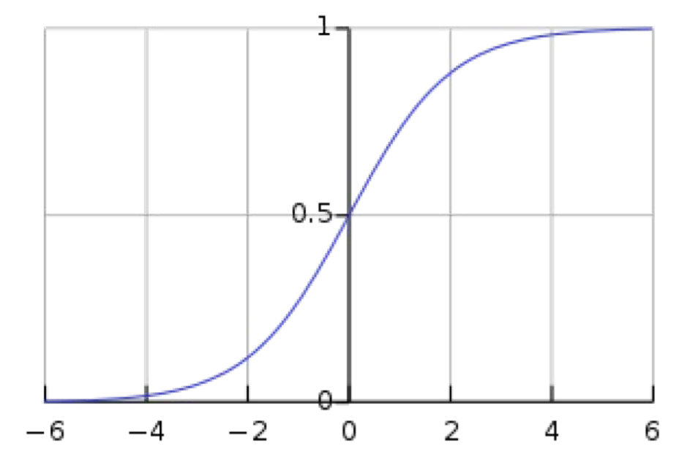
The Perceptron: Forward Propagation
Activation Functions
𝑦^ = 𝑔 𝑤₀ +𝑋^{𝑇} 𝘸
Example: sigmoid function
1
𝑤₀
𝑥₁
𝑤₁
𝑤₂
Σ
𝑦^
𝑥₂
1
𝑤
𝑔 𝑧 = 𝜎 𝑧 =
𝑚
1 + 𝑒 ^{– 𝑧}
𝑥_{𝑚}
Inputs
Weights
Sum
Non-Linearity
Output
𝑧

Slide 9
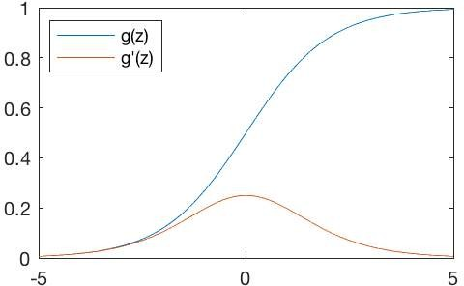
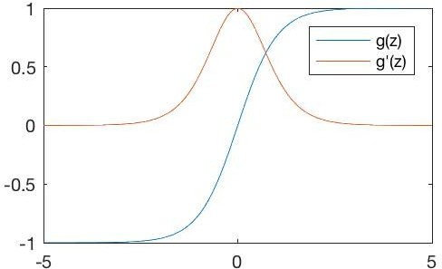
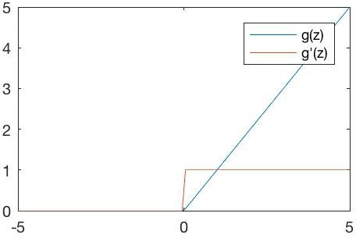
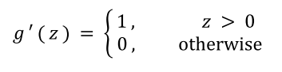



Common Activation Functions
Sigmoid Function
Hyperbolic Tangent
Rectified Linear Unit (ReLU)
1
1 + 𝑒 ^{-z}
_{𝑒} 𝑧 _{− 𝑒} - 𝑧
𝑔 𝑧 =
𝑔 𝑧
⁼ _{𝑒} 𝑧 _{+ 𝑒} - 𝑧
𝑔 𝑧 = max ( 0 , 𝑧 )
𝑔′ 𝑧
= 𝑔(𝑧) 1 − 𝑔(𝑧)
𝑔′ 𝑧 = 1 − 𝑔(𝑧)²
tf.nn.sigmoid(z)
tf.nn.tanh(z)
tf.nn.relu(z)
NOTE: All activation functions are non-linear

Slide 10
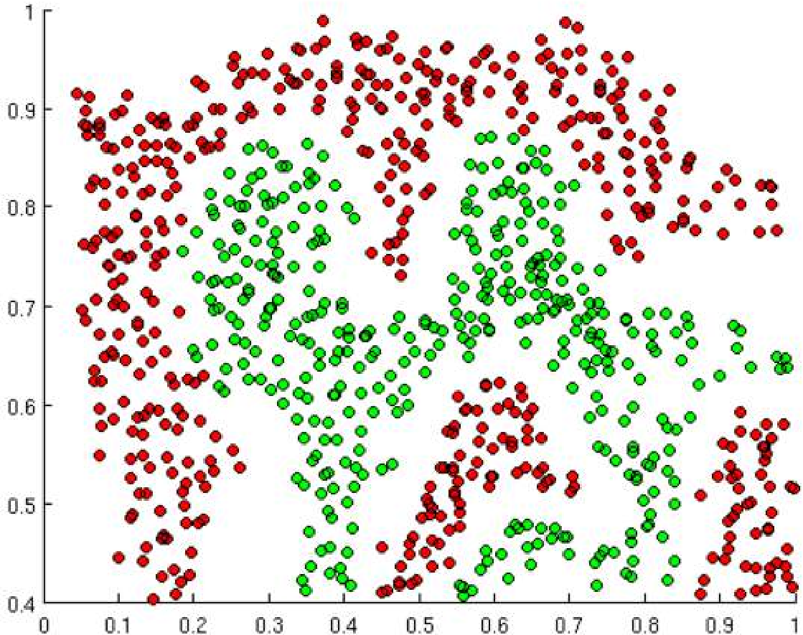
Importance of Activation Functions
The purpose of activation functions is to introduce non-linearities into the network
What if we wanted to build a Neural Network to distinguish green vs red points?

Slide 11
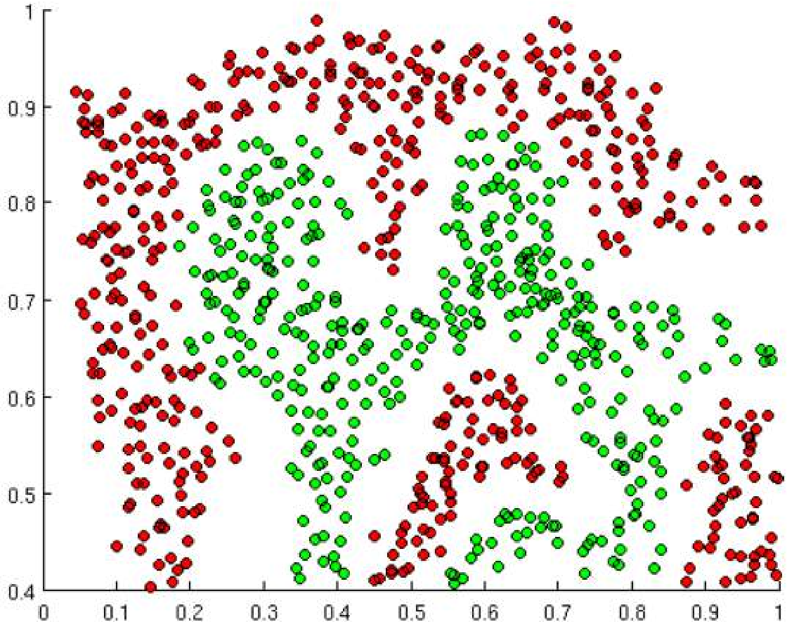
Importance of Activation Functions
The purpose of activation functions is to introduce non-linearities into the network
Linear Activation functions produce linear decisions no matter the network size

Slide 12
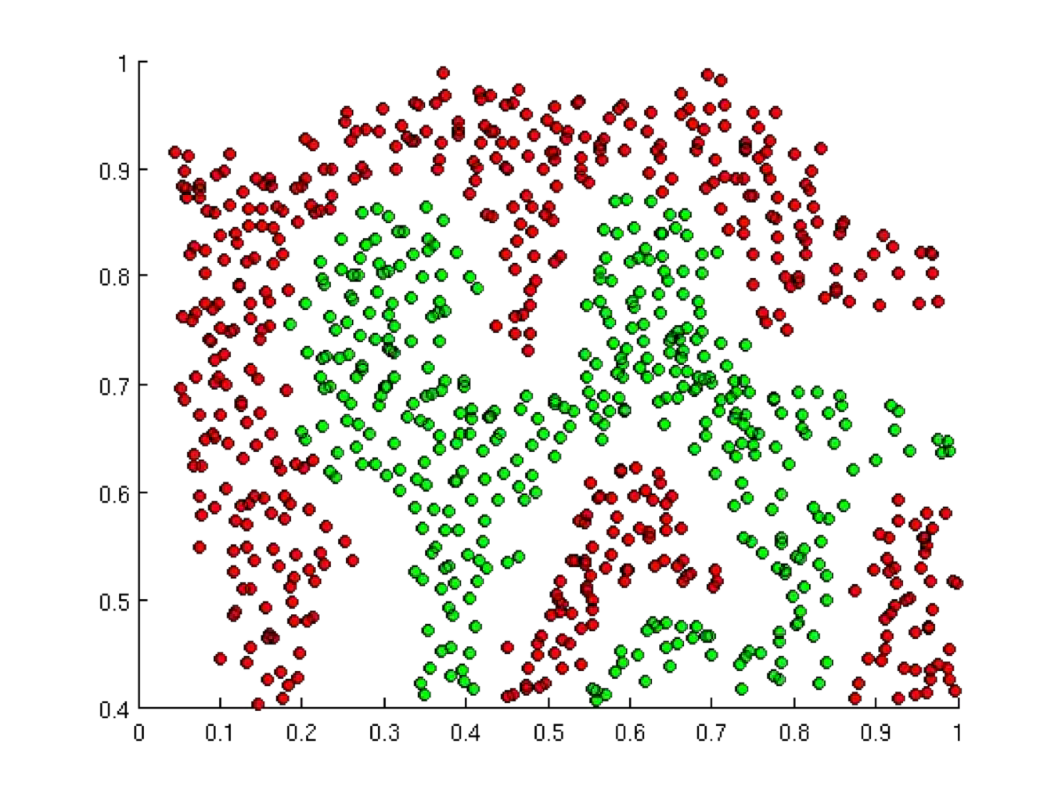
Importance of Activation Functions
The purpose of activation functions is to introduce non-linearities into the network
Linear Activation functions produce linear decisions no matter the network size
Non-linearities allow us to approximate arbitrarily complex functions

Slide 13
The Perceptron: Example
We have: 𝑤 ₀ = 1 and W =
3
− 2
1
1
𝑦^ = 𝑔 𝑤 ₀ + 𝑋 ^{𝑇} W
= 𝑔 1 +
3
Σ
𝑥 ₁
𝑇
3
𝑥
1
𝑦^
𝑥 ₂
− 2
−2
𝑦^ = 𝑔 ( 1 + 3 𝑥 ₁ − 2 𝑥 ₂ )
𝑥₂
This is just a line in 2D!

Slide 14
The Perceptron: Example
𝑦^ = 𝑔 ( 1 + 3 𝑥 ₁ − 2 𝑥 ₂ )
𝑥 ₂
1
1
= 0
2
− 2𝑥
3
Σ
𝑥
1
𝑦^
1
1 + 3𝑥
−2
𝑥 ₁
𝑥₂

Slide 15
The Perceptron: Example
𝑦^ = 𝑔 ( 1 + 3 𝑥 ₁ − 2 𝑥 ₂ )
𝑥 ₂
1
1
= 0
−1
2
2
− 2𝑥
3
Σ
𝑥₁
𝑦^
1
1 + 3𝑥
−2
𝑥 ₁
𝑥₂
− 1
2
Assume we have input: 𝑋 =
𝑦^ = 𝑔 1 +
= 𝑔 −6
3 ∗ −1 − 2 ∗ 2
≈ 0.002

Slide 16
The Perceptron: Example
𝑦^ = 𝑔 ( 1 + 3 𝑥 ₁ − 2 𝑥 ₂ )
𝑥 ₂
1
1
= 0
𝑧 < 0
𝑦 < 0.5
2
− 2𝑥
3
Σ
𝑥
1
𝑦^
1
1 + 3𝑥
−2
𝑥 ₁
𝑥₂
𝑧 > 0
𝑦 > 0.5

Slide 17

The Perceptron: Simplified
1
𝑤₀
𝑥₁
𝑤₁
𝑤₂
𝑤_{𝑚}
Σ
𝑦^
𝑥₂
𝑥_{𝑚}
Inputs
Weights
Sum
Non-Linearity
Output

Slide 18
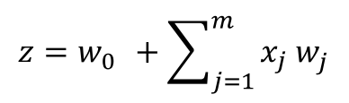
The Perceptron: Simplified
𝑥₁
𝑦 = 𝑔 𝑧
𝑥₂
𝑧
𝑥_{𝑚}

Slide 19
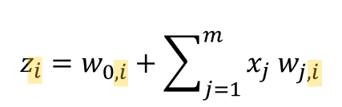
Multi Output Perceptron
𝑥₁
𝑦₁ = 𝑔 𝑧₁
𝑧
1
𝑥₂
𝑦₂ = 𝑔 𝑧₂
𝑧
2
𝑥_{𝑚}

Slide 20
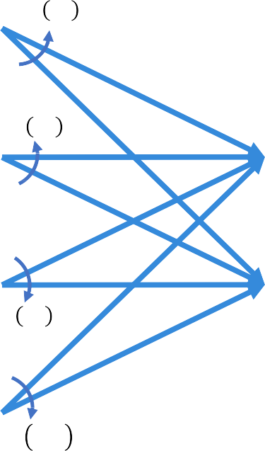
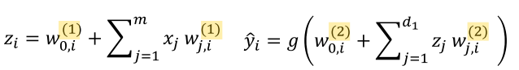
Single Layer Neural Network
_{W}(1)
_{W}(2)
𝑧
𝑔 𝑧₁
1
𝑥₁
𝑔 𝑧₂
𝑧₂
𝑦^₁
𝑥₂
𝑧₃
𝑦^₂
𝑔 𝑧₃
𝑥_{𝑚}
𝑧_{𝑑1}
𝑔 𝑧
𝑑₁
Hidden
Inputs
Final Output

Slide 21
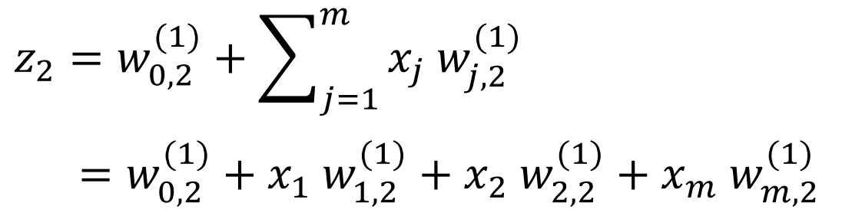
Single Layer Neural Network
𝑧₁
𝑥₁
_{𝜃}(1)
1,2
_{𝜃}(1)
𝑧₂
𝑦^₁
2,2
𝑥₂
_{𝜃}(1)
𝑧₃
𝑦^₂
𝑚,2
𝑥_{𝑚}
𝑧_{𝑑1}
_{= 𝑤}(1)
𝑚
(1)
𝑧
2
0,2 ^{+ ∑ 𝑥}j ^{𝑤}j,2
j=1
_{= 𝑤}(1) _{+ 𝑥1 𝑤}(1) _{+ 𝑥2 𝑤}(1) _{+ 𝑥𝑚 𝑤}(1) 0,2 1,2 2,2 𝑚,2

Slide 22

Multi Output Perceptron
from tf.keras.layers import *
inputs = Inputs(m)
hidden = Dense(d₁)(inputs) outputs = Dense(2)(hidden) model = Model(inputs, outputs)
𝑧₁
𝑥₁
𝑧₂
𝑦^₁
𝑥₂
𝑧₃
𝑦^₂
𝑥_{𝑚}
𝑧_{𝑑1}
Inputs
Hidden
Output

Slide 23
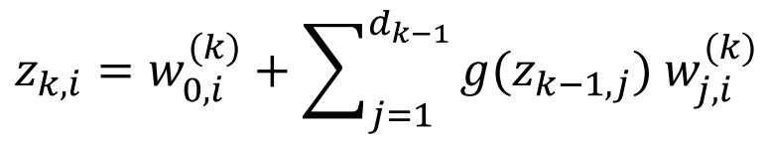
Deep Neural Network
^{𝑧}𝑘,1
𝑥₁
^{𝑧}𝑘,2
𝑦^₁
⋯
⋯
𝑥₂
^{𝑧}𝑘,3
𝑦^₂
𝑥_{𝑚}
^{𝑧}𝑘,𝑑_{𝑘}
Inputs
Hidden
Output
^{𝑑}𝑘−1
𝑧 = 𝑤^{(𝑘)} + ∑ 𝑔(𝑧
_{) 𝑤}(𝑘)
𝑘,𝑖
0,𝑖
𝑘−1,j
j,𝑖
j=1

Slide 24
Example Problem
Will I pass this class?
Let’s start with a simple two feature model
𝑥 ₁ = Number of lectures you attend
𝑥 ₂ = Hours spent on the final project

Slide 25
Example Problem: Will I pass this class?
𝑥₂ = Hours spent on the final project
Legend
Pass Fail
𝑥 ₁ = Number of lectures you attend

Slide 26
Example Problem: Will I pass this class?
𝑥₂ = Hours spent on the final project
Legend
Pass Fail
?
4
5
𝑥 ₁ = Number of lectures you attend

Slide 27
Example Problem: Will I pass this class?
𝑧₁
𝑥₁
_{𝑥} 1
= 4 , 5
𝑧₂
𝑦^₁
Predicted: 0.1
𝑥₂
𝑧₃

Slide 28
Example Problem: Will I pass this class?
𝑧₁
𝑥₁
_{𝑥} 1
Predicted: 0.1
Actual: 1
= 4 , 5
𝑧₂
𝑦^₁
𝑥₂
𝑧₃

Slide 29
Quantifying Loss
The loss of our network measures the cost incurred from incorrect predictions
𝑧₁
𝑥₁
_{𝑥} 1
Predicted: 0.1
Actual: 1
= 4 , 5
𝑧₂
𝑦^₁
𝑥₂
𝑧₃
ℒ 𝑓 𝑥^{(𝑖)}; 𝘸 , 𝑦^{(𝑖)}
Predicted Actual

Slide 30
Empirical Loss
The empirical loss measures the total loss over our entire dataset
𝑓(𝑥)
0.1
0.8
0.6
⋮
𝑦
1
0
1
⋮
𝑧₁
4, 5
2, 1
5, 8
⋮ ⋮
𝑥₁
𝑋 =
𝑧₂
𝑦^₁
𝑥₂
𝑧₃
Also known as:
Objective function
Cost function
Empirical Risk
1
𝑛
𝑛
∑ ℒ 𝑓 𝑥 ; 𝘸 , 𝑦
𝑖=1
𝐽 𝘸 =
(𝑖)
(𝑖)
Predicted Actual

Slide 31



Binary Cross Entropy Loss
Cross entropy loss can be used with models that output a probability between 0 and 1
𝑓(𝑥)
0.1
0.8
0.6
⋮
𝑦
1
0
1
⋮
𝑧₁
4, 5
2, 1
5, 8
⋮ ⋮
𝑥₁
𝑋 =
𝑧₂
𝑦^₁
𝑥₂
𝑧₃
1
𝑛
(𝑖) 𝑖
𝐽 𝘸 = _{𝑛} ∑_{𝑖=1} 𝑦 log 𝑓 𝑥 ; 𝘸 + (1 − 𝑦 ) log 1 − 𝑓 𝑥 ; 𝘸
(𝑖) 𝑖
Actual Predicted Actual Predicted
loss = tf.reduce_mean( tf.nn.softmax_cross_entropy_with_logits(model.y, model.pred) )

Slide 32



Mean Squared Error Loss
Mean squared error loss can be used with regression models that output continuous real numbers
𝑓(𝑥)
30
80
85
⋮
𝑦
90
20
95
⋮
𝑧₁
4, 5
2, 1
5, 8
⋮ ⋮
𝑥₁
𝑋 =
𝑧₂
𝑦^₁
𝑥₂
𝑧₃
1
𝑛
2
𝐽 𝘸 = _{𝑛} ∑_{𝑖=1} 𝑦
𝑖
𝑖
Final Grades (percentage)
− 𝑓 𝑥 ; 𝘸
Actual Predicted
loss = tf.reduce_mean( tf.square(tf.subtract(model.y, model.pred) )

Slide 33
Training Neural Networks

Slide 34
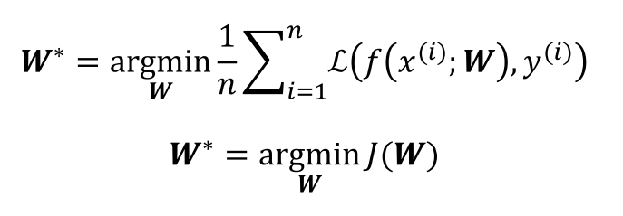
Loss Optimization
We want to find the network weights that achieve the lowest loss
1
𝑛
∗
(𝑖)
(𝑖)
𝘸 = argmin _{𝑛} ,
ℒ 𝑓 𝑥 ; 𝘸 , 𝑦
𝘸 𝑖.1
𝘸∗ = argmin 𝐽(𝘸)
𝘸

Slide 35
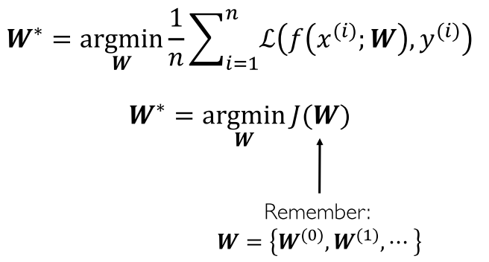
Loss Optimization
We want to find the network weights that achieve the lowest loss
1
𝑛
∗
(𝑖)
(𝑖)
𝘸 = argmin _{𝑛} ,
ℒ 𝑓 𝑥 ; 𝘸 , 𝑦
𝘸 𝑖.1
𝘸∗ = argmin 𝐽(𝘸)
𝘸
Remember:
𝘸 = 𝘸⁽⁰⁾, 𝘸⁽¹⁾, ⋯

Slide 36
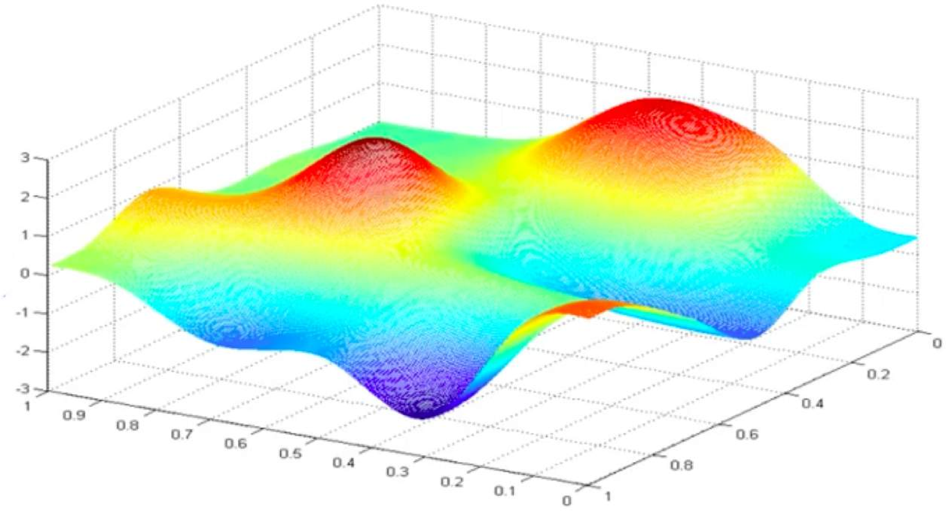
Loss Optimization
W∗ = argmin 𝐽(W)
W
Remember:
Our loss is a function of the network weights!
𝐽(𝑤₀, 𝑤₁)
𝑤₁
𝑤
0

Slide 37
Loss Optimization
Randomly pick an initial (𝑤₀, 𝑤₁)
𝐽(𝑤₀, 𝑤₁)
𝑤₁
𝑤
0

Slide 38
Loss Optimization
Compute gradient, ^{𝛛𝐽(𝘸)}
𝛛𝘸
𝐽(𝑤₀, 𝑤₁)
𝑤₁
𝑤
0

Slide 39
Loss Optimization
Take small step in opposite direction of gradient
𝐽(𝑤₀, 𝑤₁)
𝑤₁
𝑤
0

Slide 40
Gradient Descent
Repeat until convergence
𝐽(𝑤₀, 𝑤₁)
𝑤₁
𝑤
0

Slide 41



Gradient Descent
Algorithm
weights = tf.random_normal(shape, stddev=sigma)
Initialize weights randomly ~𝒩(0, 𝜎²)
Loop until convergence: 3.
4.
5. Return weights
Compute gradient, ^{𝛛𝐽(𝘸)}
grads = tf.gradients(ys=loss, xs=weights)
𝛛𝘸
Update weights, 𝘸 ← 𝘸 − 𝜂 ^{𝛛𝐽(𝘸)}
weights_new = weights.assign(weights – lr * grads)
𝛛𝘸

Slide 42
Gradient Descent
Algorithm
Initialize weights randomly ~𝒩(0, 𝜎²)
Loop until convergence:
4.
5. Return weights
weights = tf.random_normal(shape, stddev=sigma)
Compute gradient, ^{𝛛𝐽(𝘸)}
grads = tf.gradients(ys=loss, xs=weights)
𝛛𝘸
Update weights, 𝘸 ← 𝘸 − 𝜂 ^{𝛛𝐽(𝘸)}
weights_new = weights.assign(weights – lr * grads)
𝛛𝘸

Slide 43
Computing Gradients: Backpropagation
𝑤₁
𝑤₂
𝑥
𝑧₁
𝑦^
𝐽(𝘸)
How does a small change in one weight (ex. 𝑤₂) affect the final loss 𝐽(𝘸)?

Slide 44
Computing Gradients: Backpropagation
𝑤₁
𝑤₂
𝑥
𝑧₁
𝑦^
𝐽(𝘸)
𝜕𝐽(𝘸)
=
𝜕𝑤₂
Let’s use the chain rule!

Slide 45


Computing Gradients: Backpropagation
𝑤₁
𝑤₂
𝑥
𝑧₁
𝑦^
𝐽(𝘸)
𝜕𝐽(𝘸) ₌ 𝜕𝐽(𝘸)
𝜕𝑤₂ 𝜕𝑦^
𝜕𝑦^
∗
𝜕𝑤₂

Slide 46

Computing Gradients: Backpropagation
𝑤₁
𝑤₂
𝑥
𝑧₁
𝑦^
𝐽(𝘸)
𝜕𝐽(𝘸) ₌ 𝜕𝐽(𝘸)
𝜕𝑤₁ 𝜕𝑦^
𝜕𝑦^
∗
𝜕𝑤₁
Apply chain rule!
Apply chain rule!

Slide 47

Computing Gradients: Backpropagation
𝑤₁
𝑤₂
𝑥
𝑧₁
𝑦^
𝐽(𝘸)
𝜕𝐽(𝘸) ₌ 𝜕𝐽(𝘸)
𝜕𝑤₁ 𝜕𝑦^
𝜕𝑦^
𝜕𝑧₁
∗
∗
𝜕𝑧₁
𝜕𝑤₁

Slide 48
Computing Gradients: Backpropagation
𝑤₁
𝑤₂
𝑥
𝑧₁
𝑦^
𝐽(𝘸)
𝜕𝐽(𝘸) ₌ 𝜕𝐽(𝘸)
𝜕𝑤₁ 𝜕𝑦^
𝜕𝑦^
𝜕𝑧₁
∗
∗
𝜕𝑧₁
𝜕𝑤₁
Repeat this for every weight in the network using gradients from later layers

Slide 49
Neural Networks in Practice: Optimization

Slide 50
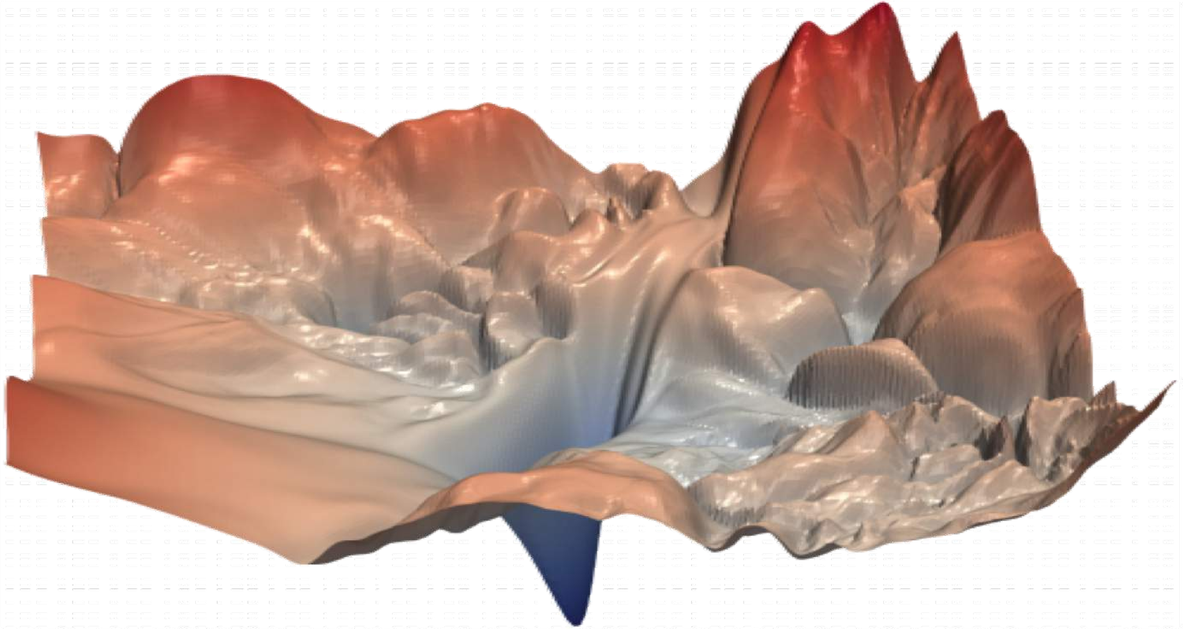
Training Neural Networks is Difficult
“Visualizing the loss landscape of neural nets”.

Slide 51
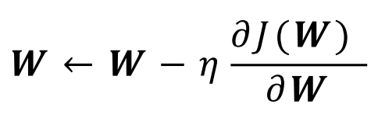
Loss Functions Can Be Difficult to Optimize
Remember:
Optimization through gradient descent
_{𝘸 ← 𝘸 − 𝜂} 𝜕𝐽( 𝘸)
𝜕𝘸

Slide 52
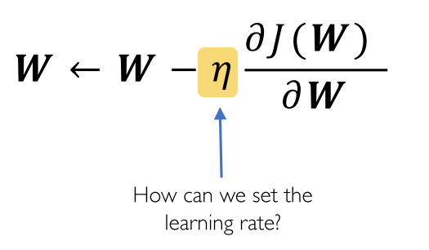
Loss Functions Can Be Difficult to Optimize
Remember:
Optimization through gradient descent
_{𝘸 ← 𝘸 − 𝜂} 𝜕𝐽( 𝘸)
𝜕𝘸
How can we set the learning rate?

Slide 53
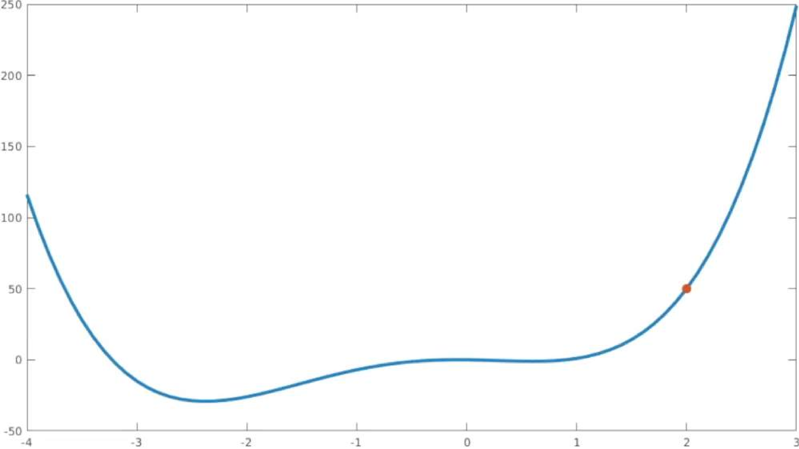
Setting the Learning Rate
Small learning rate converges slowly and gets stuck in false local minima
𝐽(𝘸)
Initial guess
𝘸

Slide 54
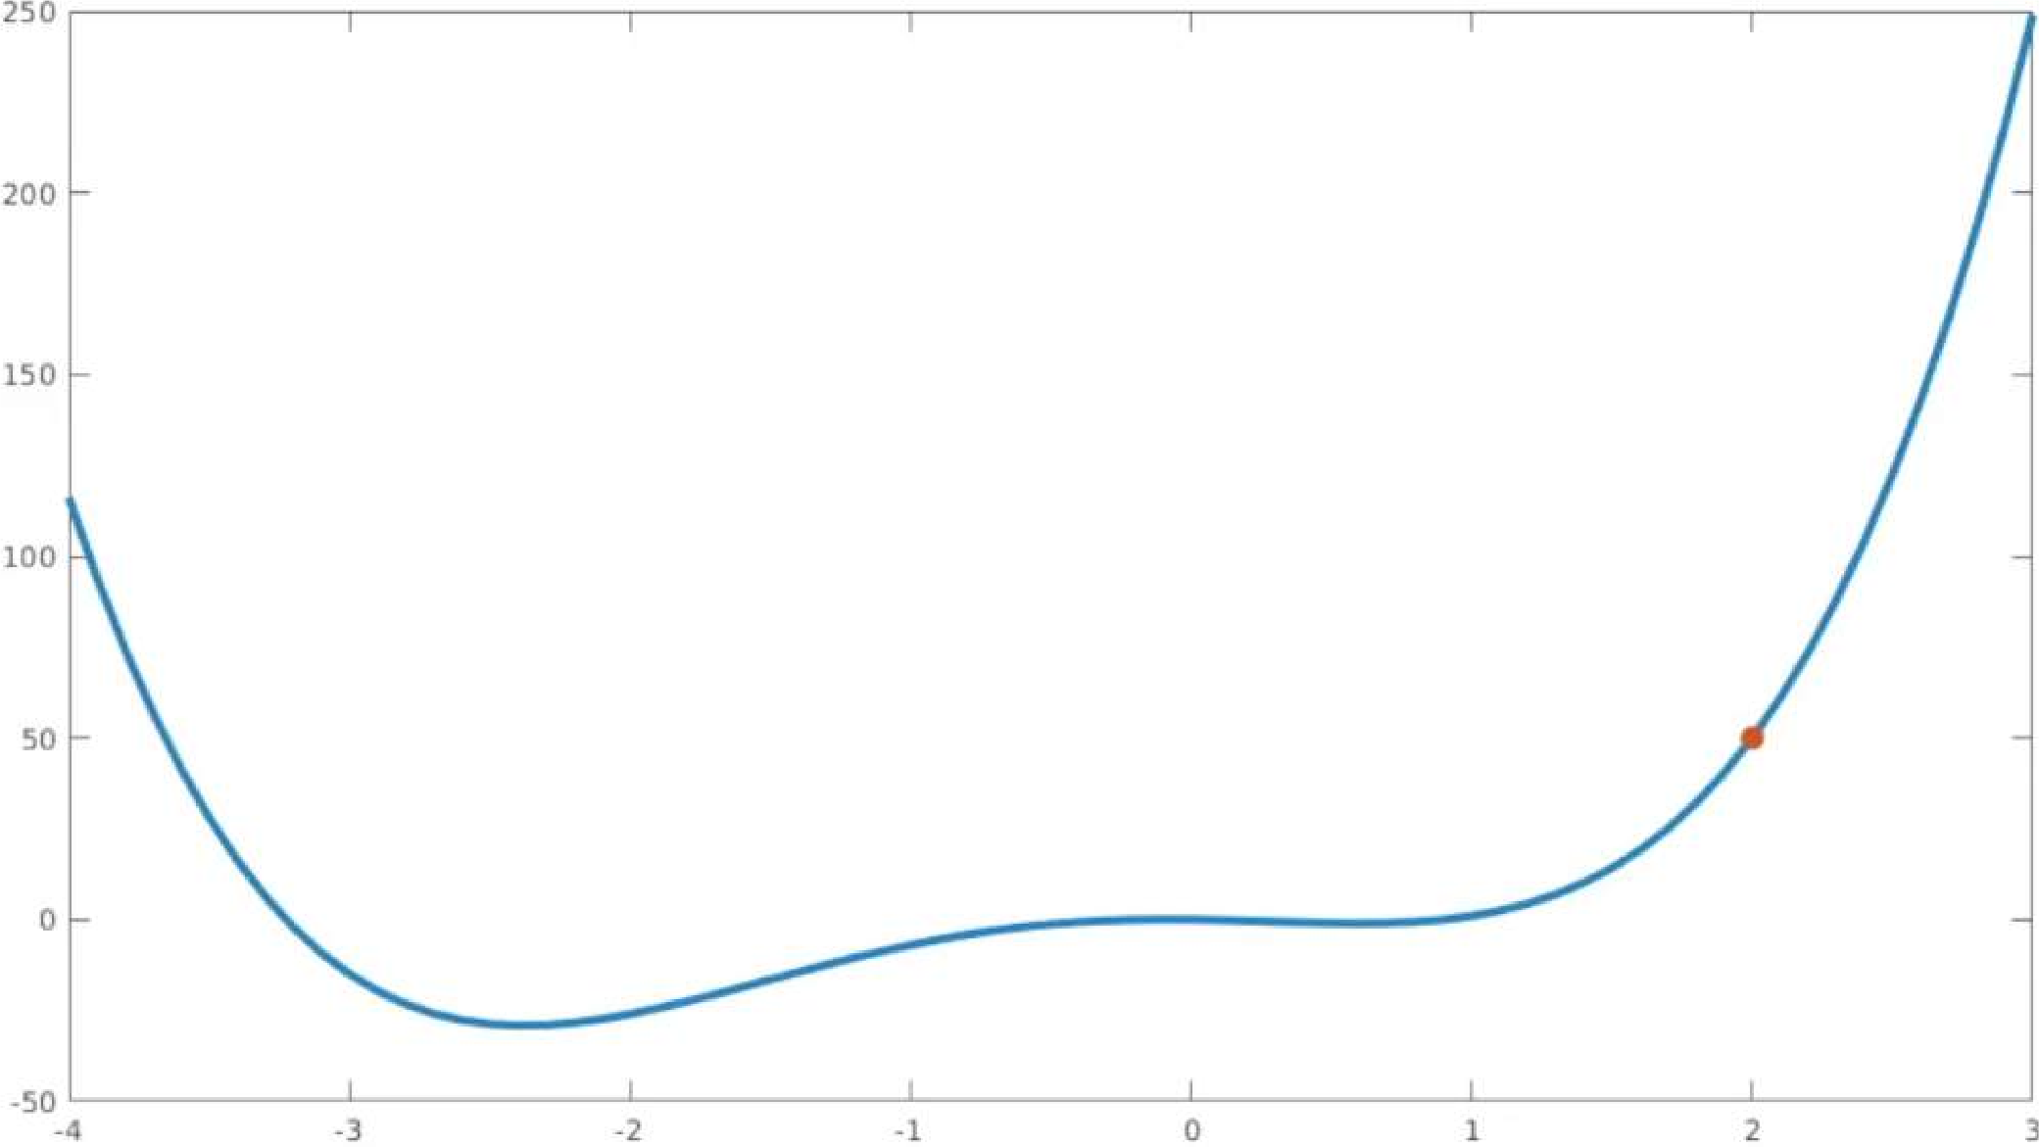
Setting the Learning Rate
Large learning rates overshoot, become unstable and diverge
𝐽(𝘸)
Initial guess
𝘸

Slide 55
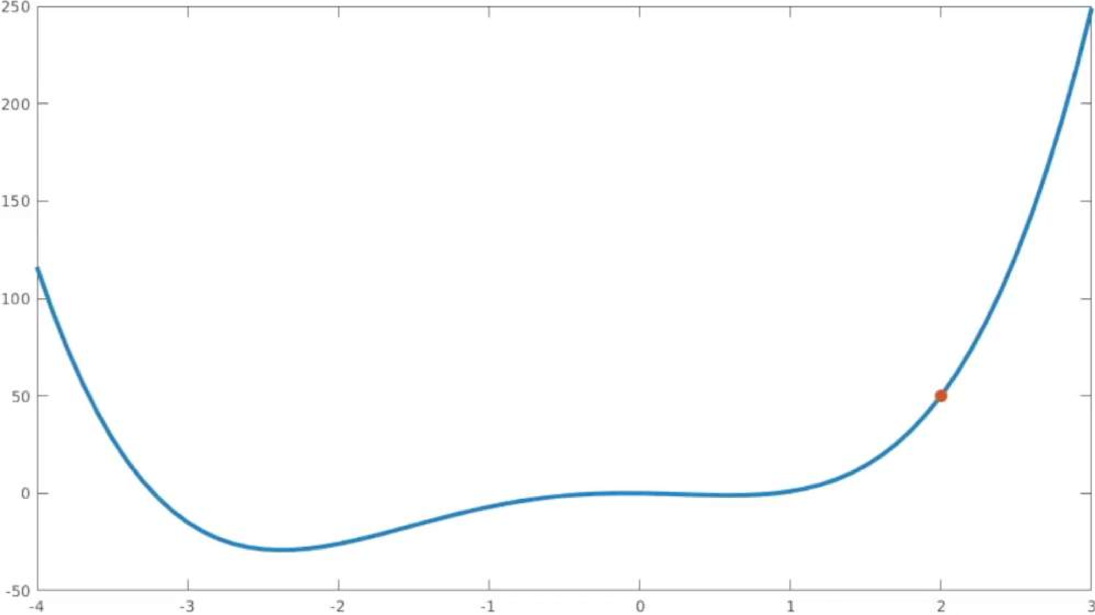
Setting the Learning Rate
Stable learning rates converge smoothly and avoid local minima
𝐽(θ)
Initial guess
W

Slide 56
How to deal with this?
Idea 1:
Try lots of different learning rates and see what works “just right”

Slide 57
How to deal with this?
Idea 1:
Try lots of different learning rates and see what works “just right”
Idea 2:
Do something smarter!
Design an adaptive learning rate that “adapts” to the landscape

Slide 58
Adaptive Learning Rates
Learning rates are no longer fixed
Can be made larger or smaller depending on:
how large gradient is
how fast learning is happening
size of particular weights
etc...

Slide 59





Adaptive Learning Rate Algorithms
Momentum
Adagrad
Adadelta
Adam
RMSProp
Qian et al. “On the momentum term in gradient descent learning algorithms.” 1999.
tf.train.MomentumOptimizer
Duchi et al. “Adaptive Subgradient Methods for Online Learning and Stochastic Optimization.” 2011.
tf.train.AdagradOptimizer
tf.train.AdadeltaOptimizer
Zeiler et al. “ADADELTA: An Adaptive Learning Rate Method.” 2012.
tf.train.AdamOptimizer
Kingma et al. “Adam: A Method for Stochastic Optimization.” 2014.
tf.train.RMSPropOptimizer
Additional details: http://ruder.io/optimizing-gradient-descent/

Slide 60
Neural Networks in Practice: Mini-batches

Slide 61
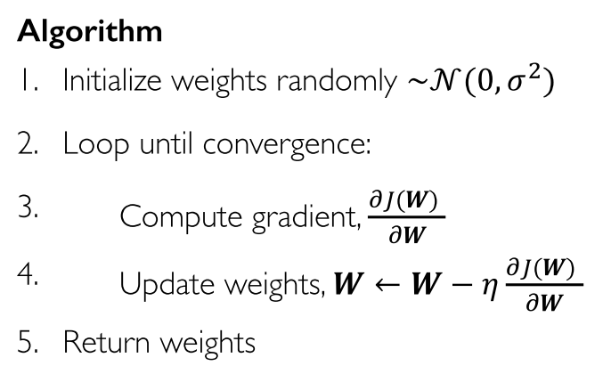
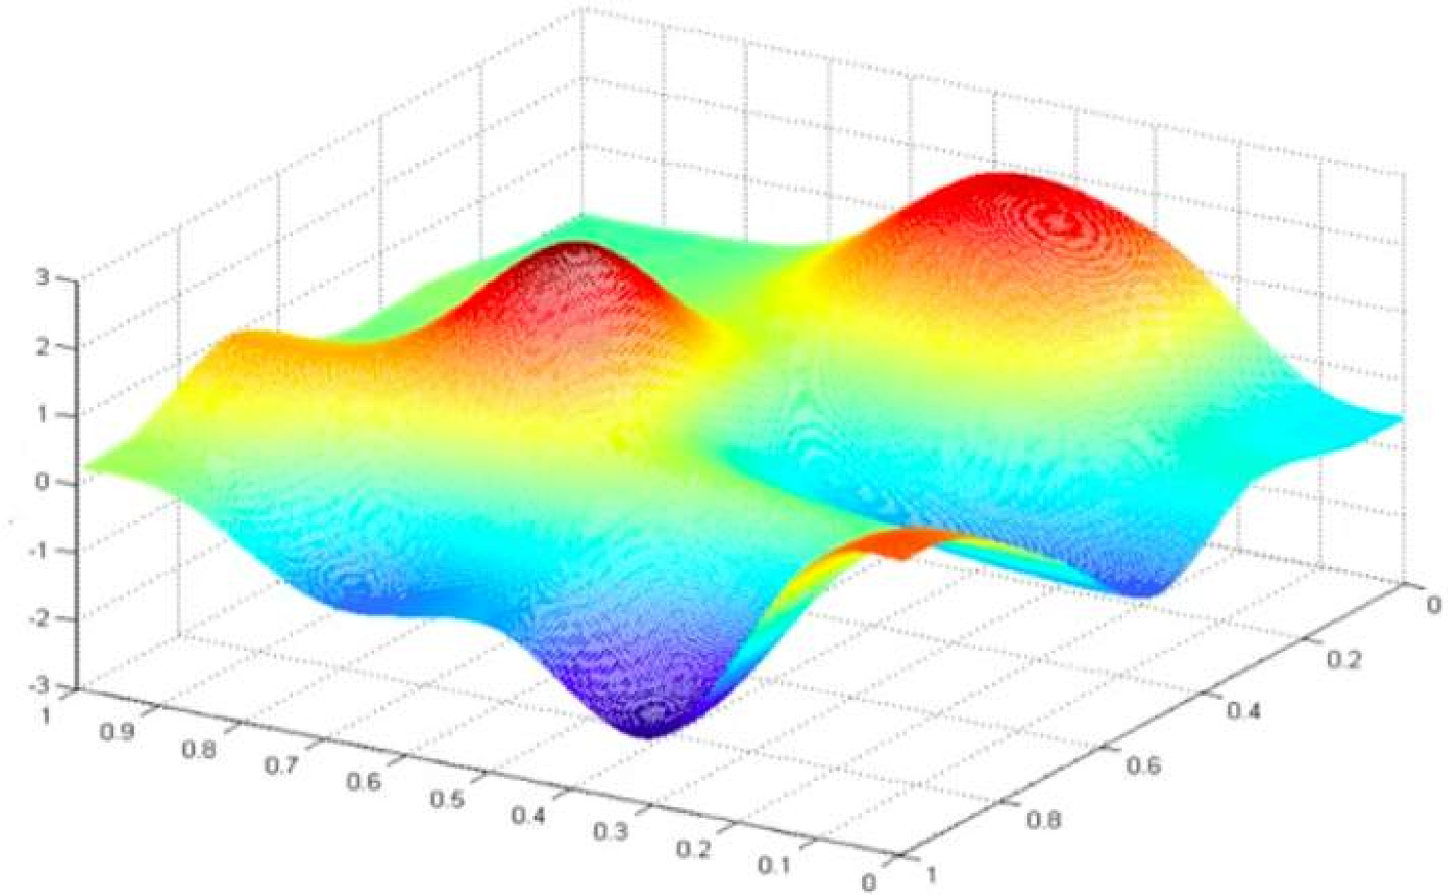
Gradient Descent
Algorithm
Initialize weights randomly ~𝒩(0, 𝜎²)
Loop until convergence:
4.
5. Return weights
Compute gradient, ^{𝛛𝐽(𝘸)}
𝛛𝘸
Update weights, 𝘸 ← 𝘸 − 𝜂 ^{𝛛𝐽(𝘸)}
𝛛𝘸

Slide 62
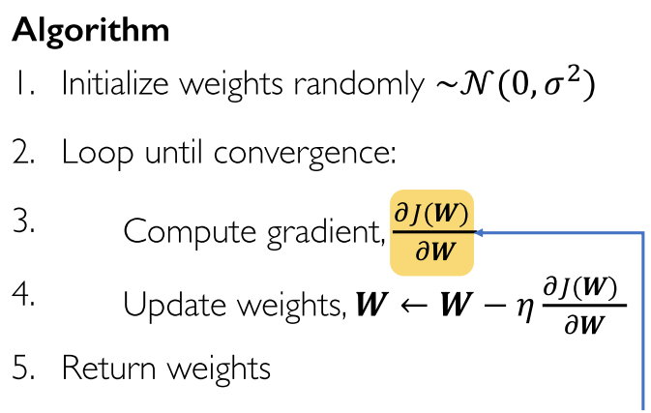
Gradient Descent
Algorithm
Initialize weights randomly ~𝒩(0, 𝜎²)
Loop until convergence:
4.
5. Return weights
Compute gradient, ^{𝛛𝐽(𝘸)}
𝛛𝘸
Update weights, 𝘸 ← 𝘸 − 𝜂 ^{𝛛𝐽(𝘸)}
𝛛𝘸
Can be very computational to compute!

Slide 63
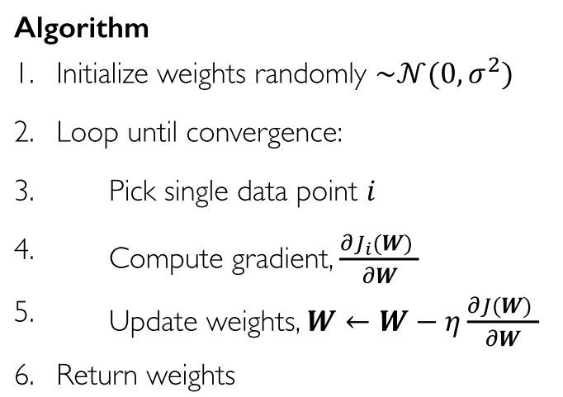
Stochastic Gradient Descent
Algorithm
Initialize weights randomly ~𝒩(0, 𝜎²)
Loop until convergence:
Pick single data point 𝑖
4.
5.
6. Return weights
Compute gradient, ^{𝛛𝐽𝑖(𝘸)}
𝛛𝘸
Update weights, 𝘸 ← 𝘸 − 𝜂 ^{𝛛𝐽(𝘸)}
𝛛𝘸

Slide 64
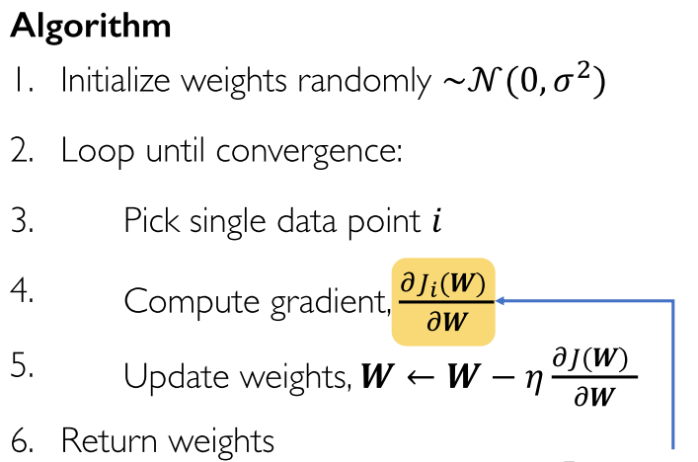
Stochastic Gradient Descent
Algorithm
Initialize weights randomly ~𝒩(0, 𝜎²)
Loop until convergence:
Pick single data point 𝑖
4.
5.
6. Return weights
Compute gradient, ^{𝛛𝐽𝑖(𝘸)}
𝛛𝘸
Update weights, 𝘸 ← 𝘸 − 𝜂 ^{𝛛𝐽(𝘸)}
𝛛𝘸
Easy to compute but very noisy (stochastic)!

Slide 65
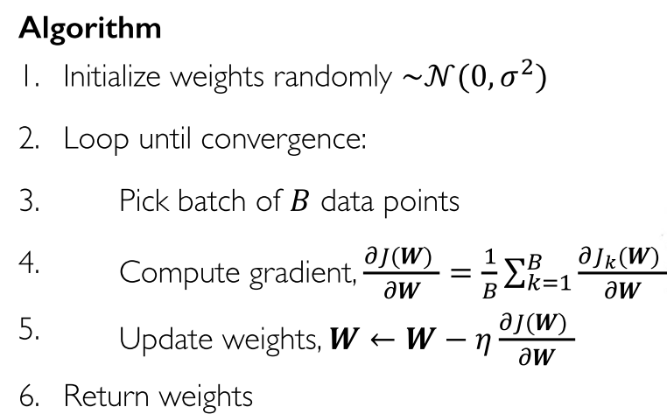
Stochastic Gradient Descent
Algorithm
Initialize weights randomly ~𝒩(0, 𝜎²)
Loop until convergence:
Pick batch of 𝐵 data points 4.
5.
6. Return weights
Compute gradient, ^{𝛛𝐽(𝘸)} = ¹ ∑^{𝐵}
𝛛𝐽_{𝑘}(𝘸)
𝛛𝘸 𝐵
𝑘21
𝛛𝘸
Update weights, 𝘸 ← 𝘸 − 𝜂 ^{𝛛𝐽(𝘸)}
𝛛𝘸

Slide 66
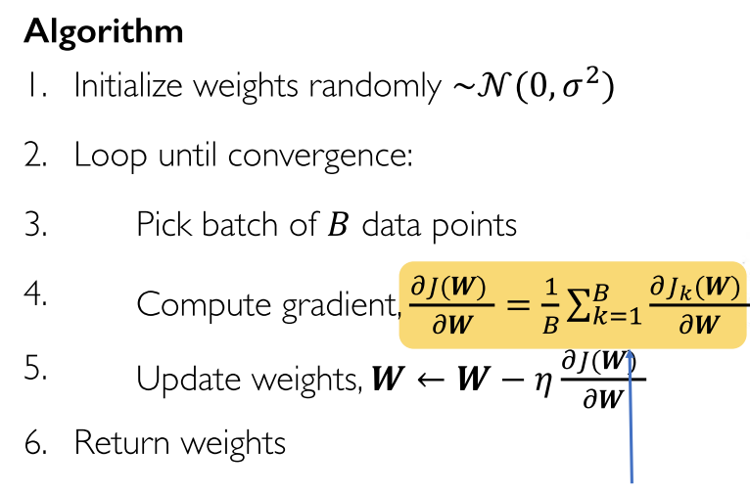
Stochastic Gradient Descent
Algorithm
Initialize weights randomly ~𝒩(0, 𝜎²)
Loop until convergence:
Pick batch of 𝐵 data points 4.
5.
6. Return weights
Compute gradient, ^{𝛛𝐽(𝘸)} = ¹ ∑^{𝐵}
𝛛𝐽_{𝑘}(𝘸)
𝛛𝘸 𝐵
𝑘21
𝛛𝘸
Update weights, 𝘸 ← 𝘸 − 𝜂 ^{𝛛𝐽(𝘸)}
𝛛𝘸
Fast to compute and a much better estimate of the true gradient!

Slide 67
Mini-batches while training
More accurate estimation of gradient
Smoother convergence Allows for larger learning rates

Slide 68
Mini-batches while training
More accurate estimation of gradient
Smoother convergence Allows for larger learning rates
Mini-batches lead to fast training!
Can parallelize computation + achieve significant speed increases on GPU’s

Slide 69
Neural Networks in Practice: Overfitting

Slide 70
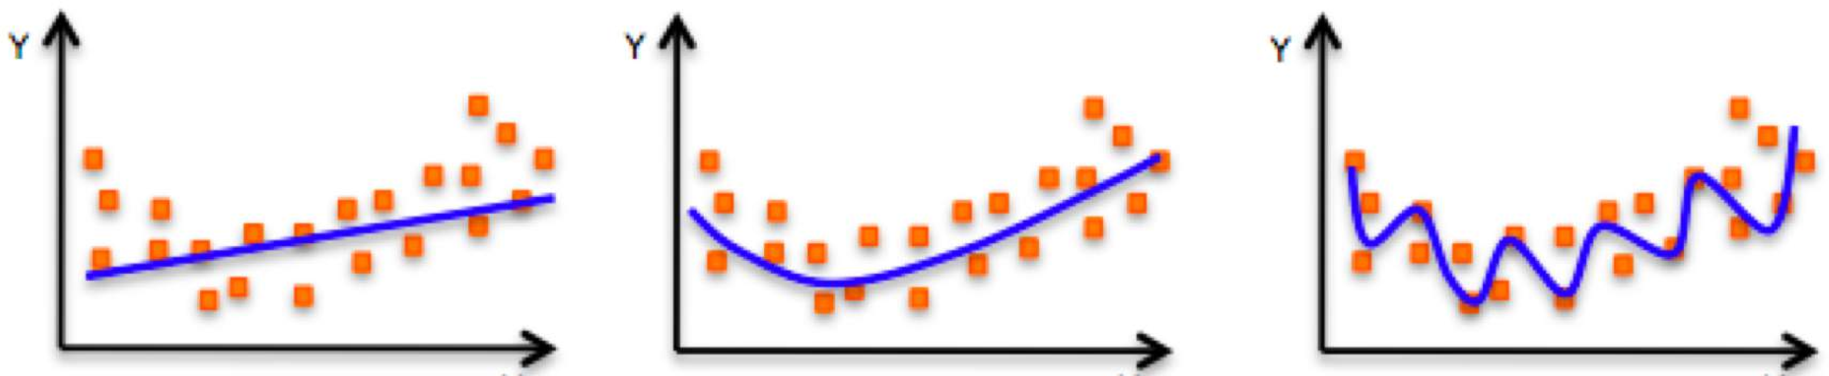
The Problem of Overfitting
Underfitting
Model does not have capacity to fully learn the data
Ideal fit
Overfitting
Too complex, extra parameters, does not generalize well

Slide 71
Regularization
What is it?
Technique that constrains our optimization problem to discourage complex models

Slide 72
Regularization
What is it?
Technique that constrains our optimization problem to discourage complex models
Why do we need it?
Improve generalization of our model on unseen data

Slide 73
Regularization 1: Dropout
During training, randomly set some activations to 0
^{𝑧}1,1
^{𝑧}2,1
𝑥₁
^{𝑧}1,2
^{𝑧}2,2
𝑦^₁
𝑥₂
^{𝑧}1,3
^{𝑧}2,3
𝑦^₂
𝑥₃
^{𝑧}1,4
^{𝑧}2,4

Slide 74

Regularization 1: Dropout
During training, randomly set some activations to 0
Typically ‘drop’ 50% of activations in layer
Forces network to not rely on any 1 node
tf.keras.layers.Dropout(p=0.5)
^{𝑧}1,1
^{𝑧}2,1
𝑥₁
^{𝑧}1,2
^{𝑧}2,2
𝑦^₁
𝑥₂
^{𝑧}1,3
^{𝑧}2,3
𝑦^₂
𝑥₃
^{𝑧}1,4
^{𝑧}2,4

Slide 75
Regularization 1: Dropout
During training, randomly set some activations to 0
Typically ‘drop’ 50% of activations in layer
Forces network to not rely on any 1 node
tf.keras.layers.Dropout(p=0.5)
^{𝑧}1,1
^{𝑧}2,1
𝑥₁
^{𝑧}1,2
^{𝑧}2,2
𝑦^₁
𝑥₂
^{𝑧}1,3
^{𝑧}2,3
𝑦^₂
𝑥₃
^{𝑧}1,4
^{𝑧}2,4

Slide 76
Regularization 2: Early Stopping
Stop training before we have a chance to overfit
Loss
Training Iterations

Slide 77




Regularization 2: Early Stopping
Stop training before we have a chance to overfit
Legend
Testing
Training
Loss
Training Iterations

Slide 78
Regularization 2: Early Stopping
Stop training before we have a chance to overfit
Legend
Testing
Training
Loss
Training Iterations

Slide 79


Regularization 2: Early Stopping
Stop training before we have a chance to overfit
Legend
Testing
Training
Loss
Training Iterations

Slide 80
Regularization 2: Early Stopping
Stop training before we have a chance to overfit
Legend
Testing
Training
Loss
Training Iterations

Slide 81

Regularization 2: Early Stopping
Stop training before we have a chance to overfit
Legend
Testing
Training
Loss
Training Iterations

Slide 82
Regularization 2: Early Stopping
Stop training before we have a chance to overfit
Legend
Testing
Training
Loss
Stop training here!
Training Iterations

Slide 83
Regularization 2: Early Stopping
Stop training before we have a chance to overfit
Under-fitting
Over-fitting
Legend
Testing
Training
Loss
Stop training here!
Training Iterations

Slide 84











Core Foundation Review
The Perceptron
Neural Networks
Training in Practice
Structural building blocks
Nonlinear activation functions
Stacking Perceptrons to form neural networks
Optimization through backpropagation
Adaptive learning
Batching
Regularization
𝑥₁
𝑥₁
^{𝑧}𝑘,1
𝑥₂
Σ
𝑦^
𝑧𝑘,2
𝑦^₁
𝑥₂
⋯
⋯
𝑥_{𝑚}
^{𝑧}𝑘,3
𝑦^₂
𝑥_{𝑚}
𝑧𝑘,𝑑_{𝑘}

